Slide 1
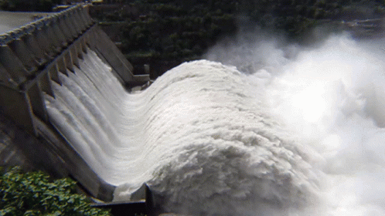

NWRB’s Groundwater Management Programs and Projects
ENGR. SUSAN P. ABAÑO
Chief, Policy and Program Division
NATIONAL WATER
RESOURCES BOARD

Slide 2
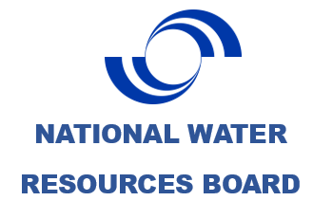
GROUNDWATER PROJECTS
PROJECT TITLE | Development of Groundwater Management Plan in Water Constrained Areas
OBJECTIVES | To effectively and equitably manage groundwater resources and provide guidance document for groundwater development in a study area considering current situation as well as future impact of climate change to ensure long –term sustainability of the resource
DURATION | One year for each water constrained areas
Output | Reports: GW vulnerability assessment, Groundwater Modeling, Network Design , Groundwater Management Plan
PROJECT SITES | Completed (Iloilo City, Cagayan de Oro City, Zamboanga City, Cebu City, Bacolod City, Angeles City, Baguio City, Metro Manila, Tagbilaran City & Panglao, Batangas City, Cavite) 2022 (On-going) -Masbate, Laguna, Bulacan 2023-Outside Metro Cebu, Puerto Princesa 2024- Calapan City, El Nido 2025- Butuan City, Naga City

Slide 3
Major River Basins
PROJECT TITLE | Comprehensive Water Resources Assessment for Major River Basins
OBJECTIVES | The study will address the limited knowledge on the current and future water resources situation. The over-all goal is to have a scientific report of the available water considering the current changes and trends in the use of water resources such as climate change and increasing developments that will be the basis for policy and planning, programming and project implementation
OUTPUT | Report: Vulnerability Assessment, Geo-Resistivity, Modeling (SW, GW),; Soil and Water Assessment Tool (SWAT), Network design, Water resources management plan
DURATION | One year for each water major river basin
PROJECT SITE | Completed (Agno River Basin, Jalaur River Basin, Panay River Basin, Davao River Basin(Region 11), Bicol River Basin) 2022 (On-going) - Cagayan de Oro River Basin, Tagoloan River Basin, Cagayan River Basin 2023- Abra River Basin, Ilog Hilabangan River Basin 2024-Tagum-Libuganon RB, Buayan-Malungon RB 2025-Abulog RB, Agusan RB

Slide 4
Establishments of Groundwater Monitoring Wells
PROJECT TITLE | Design, Drilling and Installation of Groundwater Monitoring Wells in Water Constrained Cities
OBJECTIVES | The established groundwater monitoring wells will serve as a mechanism for monitoring the effectiveness of existing groundwater policy in the area as well as basis for appropriate protection and conservation interventions.
OUTPUT | Monitoring wells
DURATION | One year to install all the monitoring wells in the constrained areas
PROJECT SITE | Completed (8 wells in Iloilo, 9 wells in Cagayan de Oro, 1 well in Bukidnon, 6 wells in Angeles, 4 in Metro Manila, 3 in Mabalacat, 3 in Bacoor, 4 in Bacolod, 1 in Talisay Negros, 4 in Metro Cebu, 1 in Talisay Cebu, 4 in Zamboanga, 2 in Batangas, 2 in Cavite, 4 in Tagbilaran, 2 in Panglao) 2019-2021(On-going) Batangas, Cavite 2022- No funds was allotted for installation of groundwater monitoring wells 2023- Laguna 2024- Bulacan 2025- Metro Manila, Cavite

Slide 5
Installation of Automatic Sensors in established Groundwater Monitoring Wells
PROJECT TITLE | Installation of Automatic Water Level and Water Quality sensors in established groundwater monitoring wells
OBJECTIVES | To be able to have real time data on water level and water quality for decision making. There are 22 selected sites where the automatic sensors will be installed. A system was also established to transfer data from the monitoring wells to NWRB website.
Output | Monitoring well with automatic sensors (water level and water quality) transmitted to the web
DURATION | One year to install all the water level and water quality sensors in the monitoring wells selected
PROJECT SITE | 2022 (On-going) Iloilo, Cagayan De Oro, Bukidnon, Metro Manila, Angeles Proposals 2023- Tagbilaran, Panglao 2024- Cavite, Batangas 2025-Laguna 2026- Bulacan

Slide 6
NWRB Foreign Assisted and Special Projects
NATIONAL WATER
RESOURCES BOARD

Slide 7
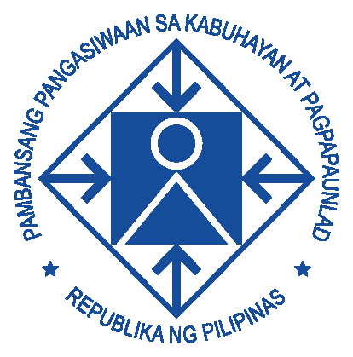
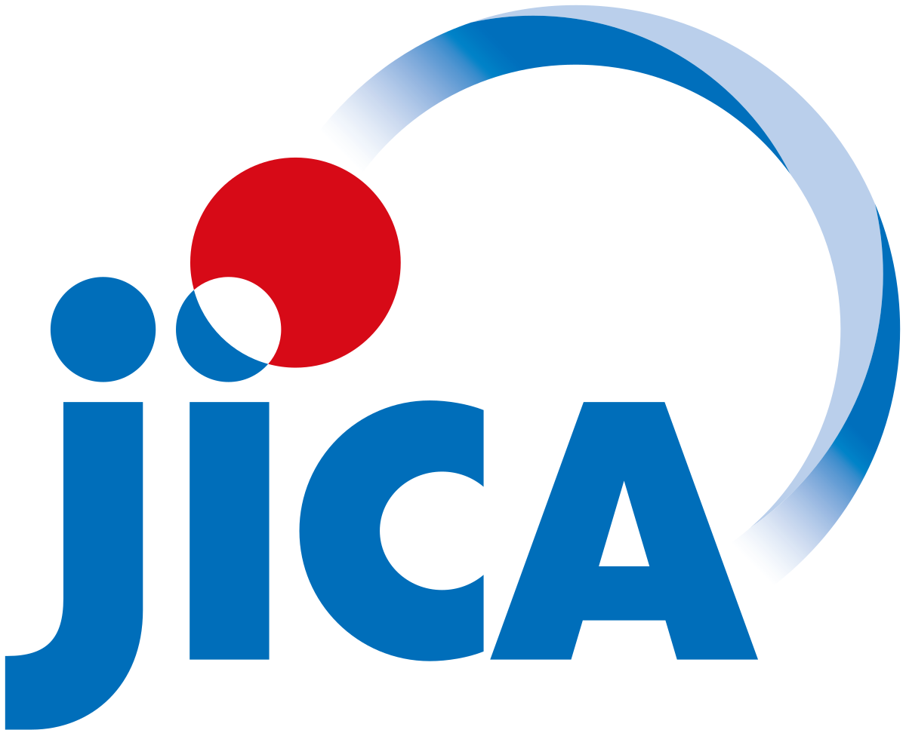

JICA-NEDA-NWRB PROJECT
PROJECT TITLE | Data Collection Survey for National Water Resources Development and Management in the Republic of the Philippines
OBJECTIVES | The data collection survey aims to collect necessary data and information and to conduct water balance analyses as inputs to the formulation of a water resource development and management master plan.
BRIEF SUMMARY | The study involves the collection of necessary information and data to understand the nationwide water balance, formulate water resource development and management master plans for selected priority areas with large water balance gaps, and propose effective countermeasures for such areas. Likewise, it will help update the Japan International Cooperation Agency (JICA)-assisted National Water Resources Management Master Plan in the Republic of the Philippines prepared in 1998.
OUTPUT | Water resource assessment (modeling tool), updated data
DURATION | 2021 – 2022
PROJECT SITE | Nationwide (with three priority water resource regions [WRR])Region 5, 7, 11
IMPLEMENTING AGENCIES | NEDA, NWRB, NGAs

Slide 8
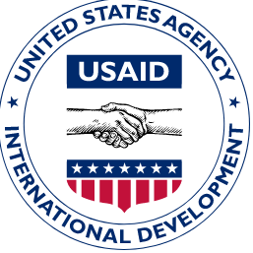
SAFE WATER ACTIVITY WITH U.S. Agency for International Development (USAID)
PROJECT TITLE | Safe Water Activity
PURPOSE | Aims that after five years, local government units (LGUs), water service providers (WSPs), and watershed councils (WCs) in the selected areas will have the information, incentives, and partnerships to identify and address barriers to a water-secure future-yielding, life-saving gains in access to water supply and sanitation (WSS) services. This will specifically address the needs of the unserved and underserved households in the Philippines' most water-stressed communities. The Safe Water team will enable and sustain this expansion in access by developing and reinforcing the systems that underpin and deliver vital WSS services while also managing and protecting the crucial upstream water resources on which these communities depend.
OUTPUT | Water resources assessment, policies, capacity building
DURATION | 5 years program (Provinces of Palawan, Negros Occidental, General Santos and neighboring Saranggani , Bacolod City, Buayan Malungon River Basin
IMPLEMENTING AGENCIES | NWRB, USAID

Slide 9
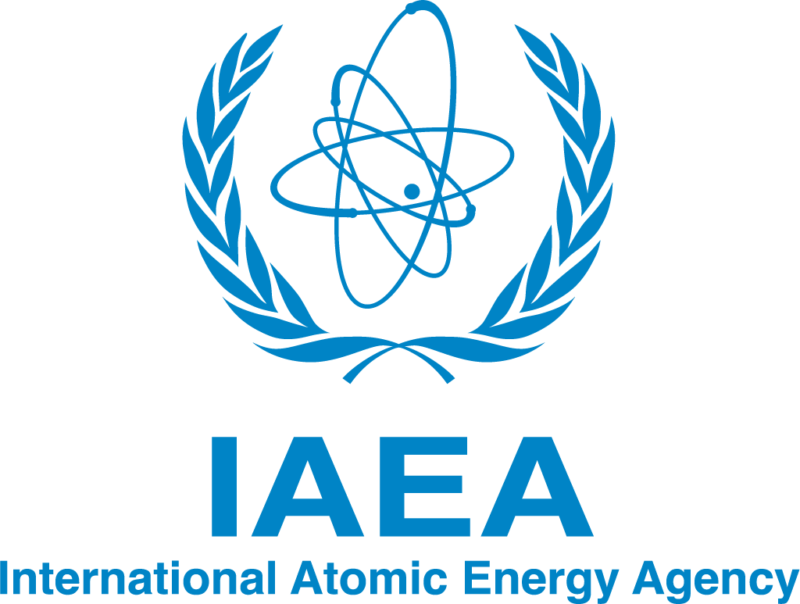


International Atomic Energy Agency (IAEA) PROJECT
PROJECT TITLE | Validation of Groundwater Vulnerability Assessment Using Hydrochemical and Isotopic Analysis
COMPONENTS | - Assessment of data needs and data collection (project inventory, data inventory, water sampling and analysis) Analysis and interpretation of hydrogeological, hydrochemical and isotopic data - Preparation of groundwater vulnerability assessment maps Report Generation • Policy formulation and recommendations Capacity building, hands on exercises in all the activities Presentation of results to NWRB Management, stakeholders in selected study areas.
DURATION | Aug 2020- December 2022
STATUS | On-going.
IMPLEMENTING AGENCIES | NWRB in collaboration with Philippine Nuclear institute (PNRI) and the International Atomic Energy Agency (IAEA)

Slide 10
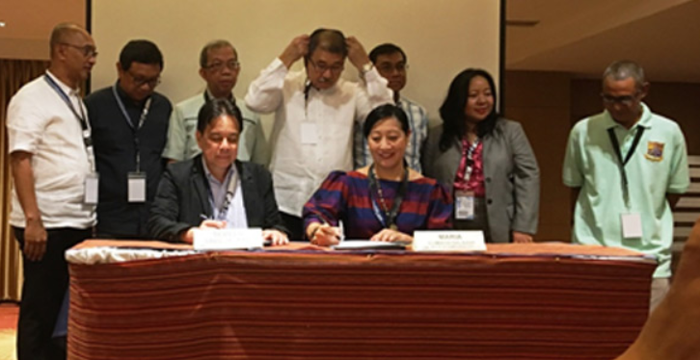
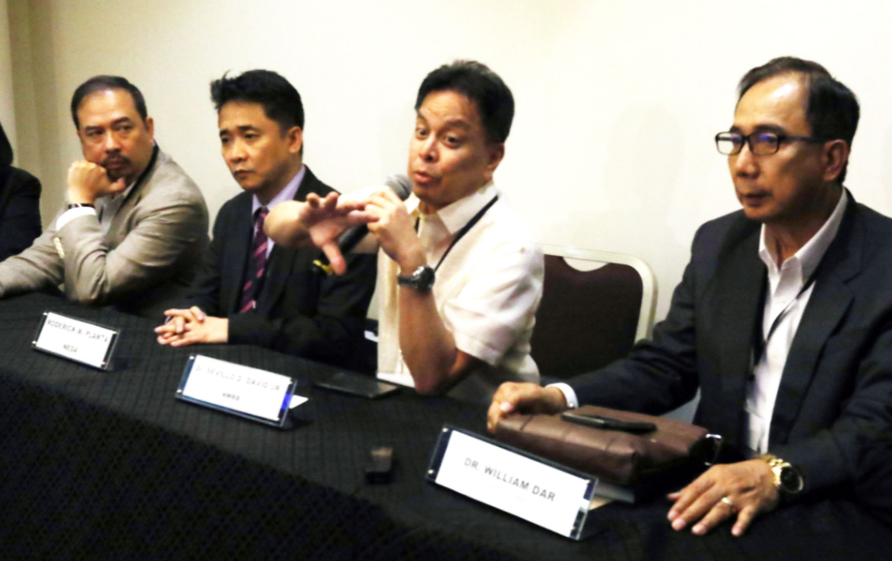

PROJECTS OF OTHER AGENCIES IN COLLABORATION WITH NWRB
NATIONAL WATER
RESOURCES BOARD

Slide 11
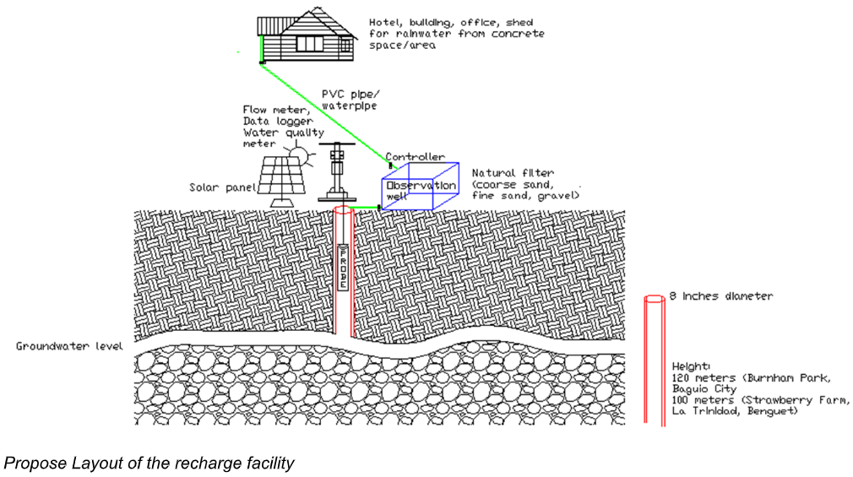


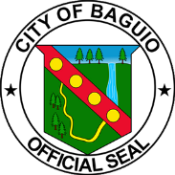

Development of Artificial Groundwater Recharge Facility for Drought and Flood Mitigation
Cooperating Agencies: LGUs of Baguio and La Trinidad, Benguet, NWRB/LWUA/ City Water District, UP/ ADMU, PNRI
Brief Summary: Development of an artificial groundwater recharge system is an intervention that increases infiltration rate into the aquifer during the rainy season for future water extraction when needed. This systematized artificial injection is different from the current intervention that is capital intensive, low storage capacity and needs larger space to store water. The infiltration rate of natural recharge is very poor in urban areas because of increasing impermeable areas like concrete grounds, buildings and other structures. Artificial groundwater recharge facilities help reduce rain runoff and minimize flooding during the rainy season.

Slide 12
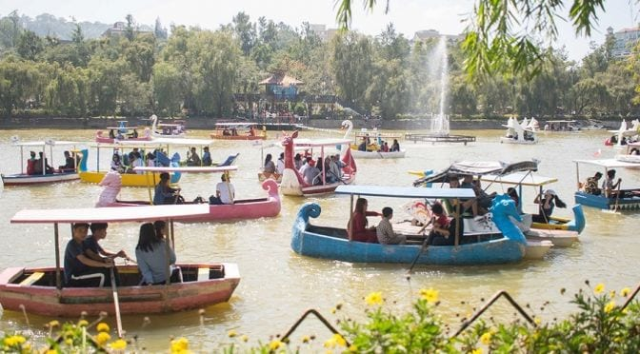
Cont. Development of Artificial Groundwater Recharge Facility for Drought and Flood Mitigation
Target Accomplishments and Expected outputs:
· MOA with the LGUs;
· Comprehensive report on the study areas including isotope analysis;
· Design of the proposed system;
· Actual prototypes installed in the study areas;
· Report on the effectiveness of the system; and
· Protocols/Guidelines Manual.
Potential applicability of the proposed facility in other areas:
After the analysis of the cost effectiveness of the proposed Artificial Groundwater Recharged System, a protocol/guidelines will be developed and this can also be implemented in other regions to address flooding, drought, improved groundwater resources for domestic, agriculture and industrial uses.
Target Beneficiaries: LGUs of Baguio City and La Trinidad, Local Water Districts, ther Groundwater Users (community, farmers)
Consultant: Watershed and Water Resources Research, Development and Extension Center

Slide 13

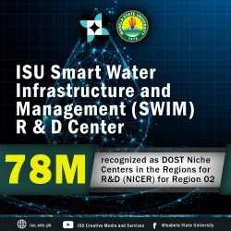
Establishment of Smart Water Infrastructure
and Management(SWIM) Research and Development Center
Cooperating Agencies: Isabela State University - DOST under
its S4CP-NICER Program.
Fund: DOST’s Niche Centers in the Regions for R&D (NICER).
Objective: The program aims to establish and institutionalize a university-based water resource center that with a mandate to undertake Research &Development, Extension, Education and Capacity Development on the areas of water resources development, management and disaster prevention. More than 30 groundwater monitoring wells will be established.
Component: Installation of permanent groundwater stations and preparation of comprehensive water resources management in selected LGU’s in the Region. NWRB to collaborate on the data/technology sharing, capacity building, policy development and joint research activities.

Slide 14
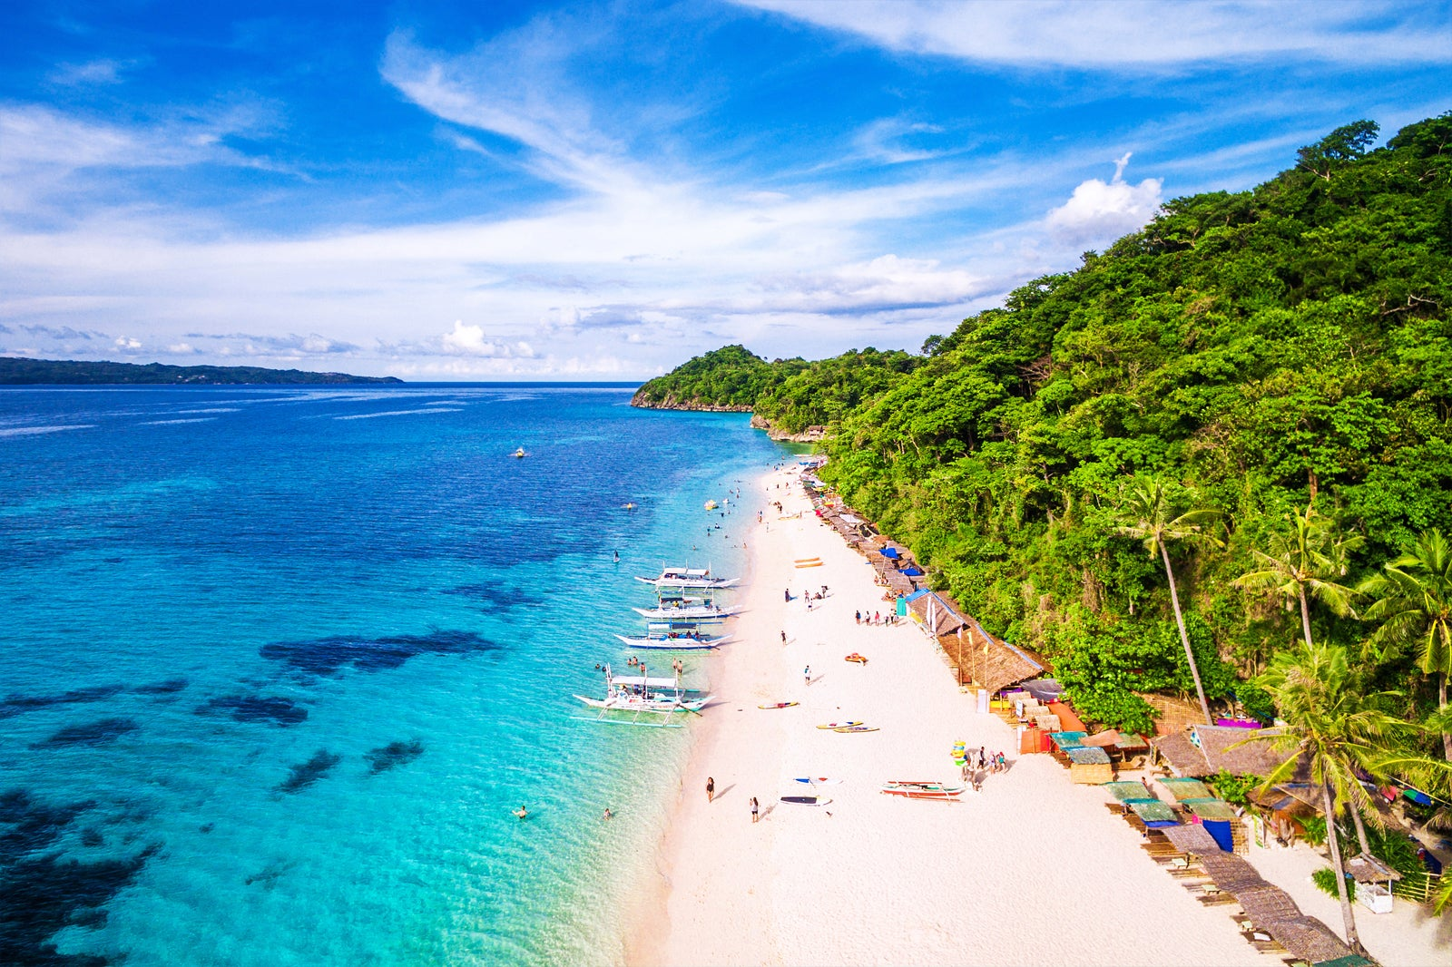


Comprehensive Water Resources Assessment and Management Plan for Nabaoy River Watershed and Boracay Island
PROJECT 1: Water Resources Assessment and Management plan for Boracay Island and Nabaoy Watershed
Duration: 18 months
Cooperating Agency: Ateneo De Manila University, DOST-PNRI, NWRB
Funding: DOST-PCIEERRD
Boracay will serve as a test case in developing science-based monitoring techniques and planning guidelines for sustainable water resource management on tourist islands. The program is to provide a comprehensive understanding on the water conditions and outlook on the island.

Slide 15
Comprehensive Water Resources Assessment and Management Plan for Nabaoy River Watershed and Boracay Island
PROJECT 2: Hydrological characterization of Boracay Island’s groundwater system and Nabaoy River Watershed using Isotope and Nuclear Based Analytical Techniques
Duration: 18 months
Cooperating Agency: Philippine Nuclear Research Institute,
Ateneo De Manila University
National Water Resources Board
Funding: DOST-PCIEERRD

Slide 16
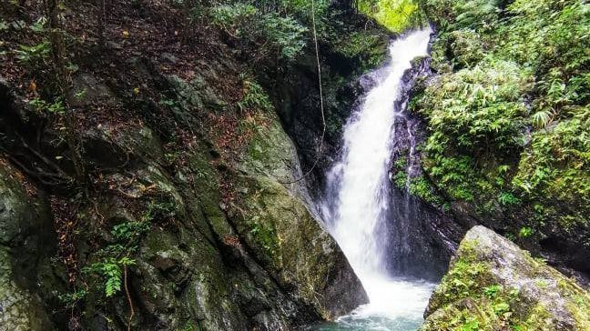
Cont. Comprehensive Water Resources Assessment and Management Plan for Nabaoy River Watershed and Boracay Island
Advanced surveying and monitoring technology will be used to assess and map the water resources and position of groundwater aquifers in the Nabaoy River Watershed resulting in guidelines for both surface and groundwater resources.
Water quality and quantity evaluation, as well as the development of a water projection/forecasting tool for both surface and groundwater reservoirs will be generated.
In the Nabaoy Watershed and on Boracay Island, isotope methods and classical hydrology will be used to evaluate water quality and quantity, identify groundwater system dynamics, recharge mechanisms, possible degradation, and looming sources of pollution. The information gathered will be utilized to construct a short-medium-long-term management strategy, which will include water infrastructure plans, initiatives, and policies.

Slide 17

Development of the Philippine Groundwater Health
Index for monitoring groundwater and agricultural areas
Cooperating Agencies: University of the Philippines Diliman, University of the Philippines Los Baños, Department of Environmental and Occupational Health, University of the Philippines Manila and DOST-PCAARRD.
Objective: To develop a multi-indicator index to describe groundwater conditions. Specifically, the project will
(1) Determine the taxonomy and ecology of groundwater biota in selected
Philippine groundwaters;
(2) Develop a weighted groundwater health index using biological
indicators, water quality, geological characteristics, and other
environmental stressors; and
(3) Develop educational materials for capability building and inputs in
formulating policy on groundwater resources.
(4) Install prototype automatic sensors at NWRB groundwater monitoring
wells
Duration: 3 years (2021-2023)
Beneficiaries: The technical staff of partner government agencies and local government units and faculty members of SUCs/HEIs will be trained using the PGHI.

Slide 18
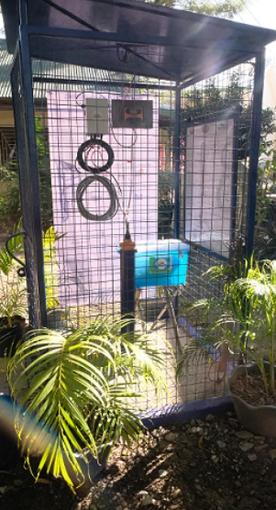
Gender and Development (GAD) Initiatives
Goal: Improved participation of women in Water Resources
management consultation processes, community
organization and decision making and ensure equal
access of women to goods and services.
Conduct of orientation seminars and other awareness raising activities to men and women on use and importance of groundwater monitoring wells ( 30 women participated in the activities)
Conduct of consultations and training to women on water conservation and water demand management ( 20 women participated)
Conduct of training to men and women on water resources management and related technologies specifically on rainwater harvesting (30 women participated)

Slide 19
Gender and Development (GAD)
Gender Challenges Addressed by NWRB projects:
Limited awareness and participation of women in water related activities and technologies
Limited access of women to information, skills, knowledge on water resources management
How many women are involved?
The Team Leader and staff of some of the projects are women
How would men and women benefit from these projects
Increased and active participation of women in the conduct of water related activities
Equal opportunity in accessing water related IEC materials developed/conducted
Harness both men and women’s knowledge in water resources management.

Slide 20

THANK YOU FOR LISTENING!

