Slide 1

ASSESSMENT OF GROUNDWATER
RESOURCES IN THE PHILIPPINES
Ms. Marnette B. Puthenpurekal
Officer-In-Charge
Hydrogeology and Environmental Geology Section (HEGS)
Lands Geological Survey Division (LGSD)
Mines and Geosciences Bureau
DEPARTMENT OF ENVIRONMENT AND NATURAL RESOURCES
Learning Event on “Well Development and Groundwater Management”
Philippine Association of Water Districts (PAWD) Convention
MJ Hotel and Suites, Cebu City
15 June 2022

Slide 2

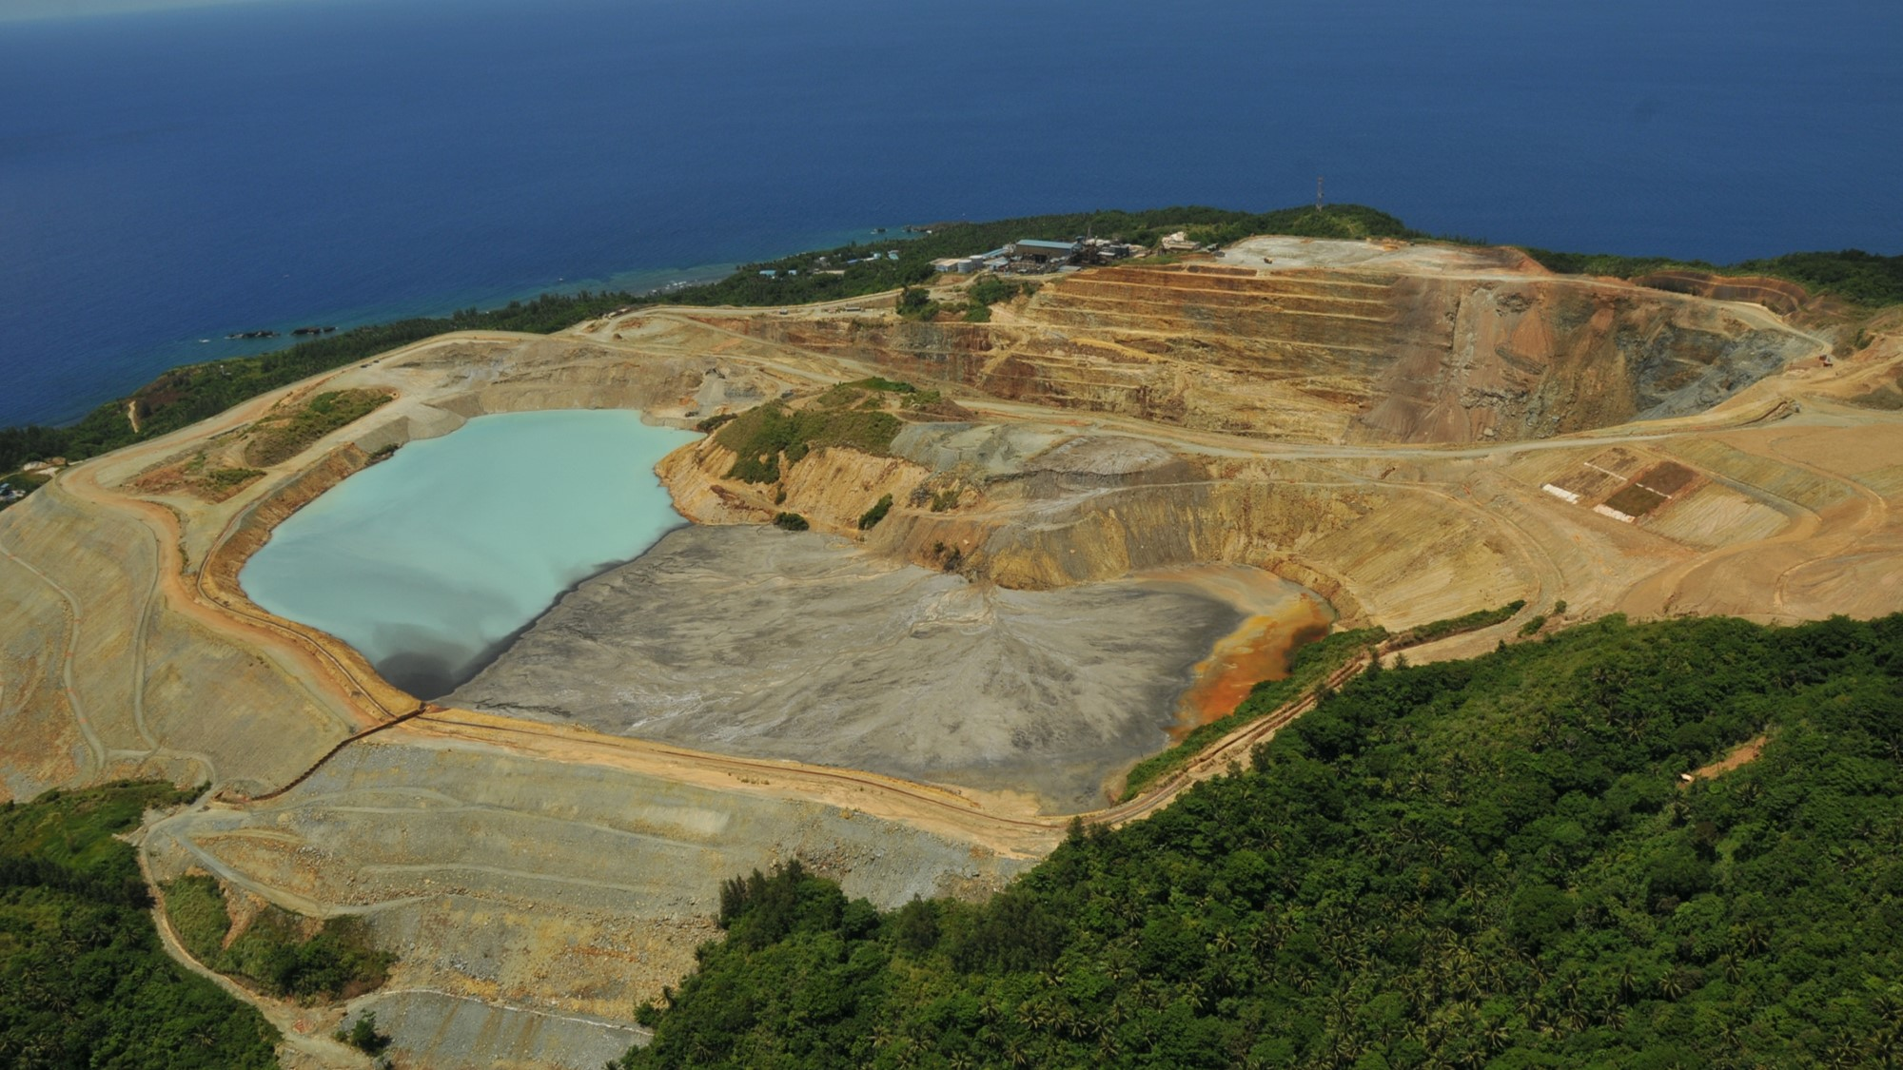
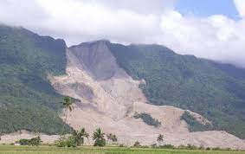
MGB is the agency that is directly in charge in
the administration and disposition of the country’s mineral lands and mineral resource
MAJOR PROJECTS/PROGRAMS/ACTIVITIES ( PPAs)
Mining Sector
Geological Sciences Sector
Geohazard Assessment
Program
Mineral Investment Promotion Program
Geologic Survey and
Exploration Program
Mining Industry Development Program
Mine Rehabilitation Program
Mineral Reservation Project
Groundwater Resource Assessment Program

Slide 3
MGB is the agency that is directly in charge in
the administration and disposition of the country’s mineral lands and mineral resource
MAJOR PROJECTS/PROGRAMS/ACTIVITIES ( PPAs)
Mining Sector
Geological Sciences Sector
Geohazard Assessment
Program
Mineral Investment Promotion Program
Geologic Survey and
Exploration Proram
Mining Industry Development Program
Mine Rehabilitation Program
Mineral Reservation Project
Groundwater Resource Assessment Program

Slide 4

The “NATIONAL GROUNDWATER RESOURCE AND VULNERABILITY ASSESSMENT PROGRAMME (NGRVAP)”
OBJECTIVE
assess the availability of groundwater within the various geologic formations underlying the entire country
assess its potential and its vulnerability to contamination within the different watersheds or basins.

Slide 5
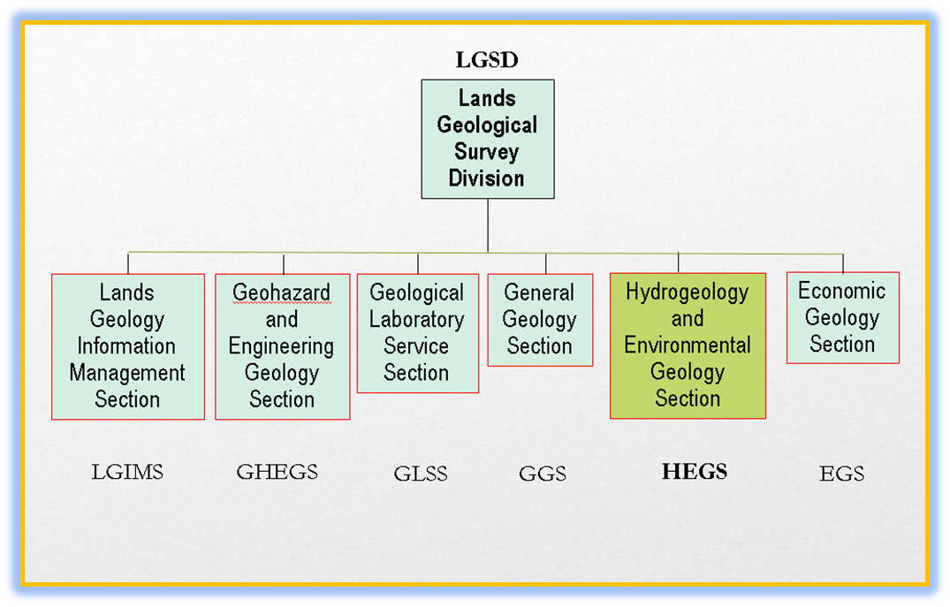
The “NATIONAL GROUNDWATER RESOURCE AND VULNERABILITY ASSESSMENT PROGRAMME (NGRVAP)”
Implemented Nationwide
Regular funding from the GAA
Implementation started in the
late 1980s
Notes:
It is implemented nation wide. Chart on the left show an organizational structure
It receives regular funding the government, and therefore it is implemented essentially using taxpayers money, budget hearing defense
It started in the late 1980’ s . although it was not implemented in a systematic manner , the conduct of assessment was based on demand and request ( demand driven), done long before the onset of the digital age, maps manually generated

Slide 6
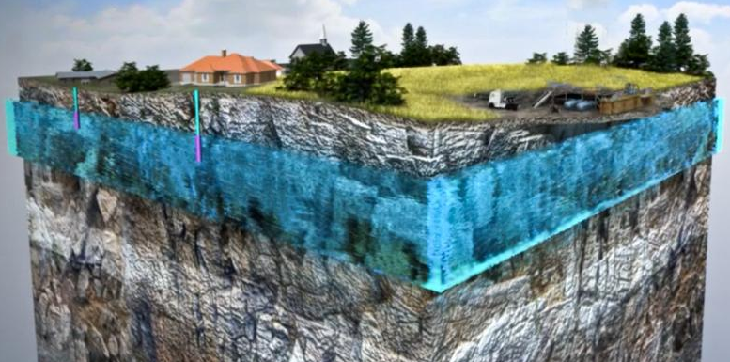
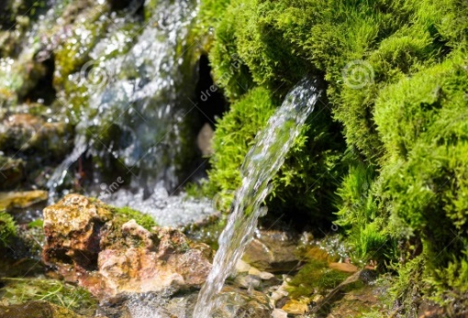
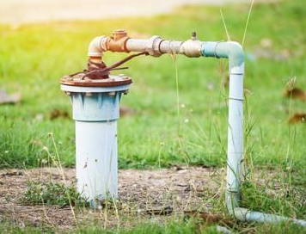
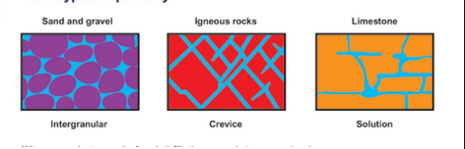
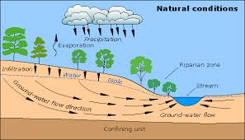
The “NATIONAL GROUNDWATER RESOURCE AND VULNERABILITY ASSESSMENT PROGRAMME (NGRVAP)”
Groundwater
is classified as natural
mineral Resource
Water within the earth’s subsurface; its invincible anddynamic
It represent 28% of the earth’s fresh water
Extracted through wells and springs
Occurs in intergranular
spaces, fractures, solution openings
It is part of the hydrologic cycle and moves from high pressure areas to low pressure areas
Notes:
It is dynamic; always in motion and it move from high pressure area to low pressure area
It is a natural mineral resource referred to as the “New Gold” dut to its extreme importance to human existence

Slide 7
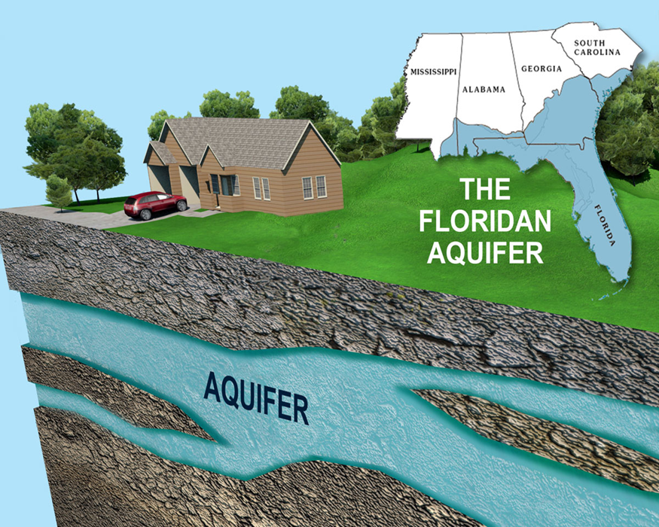
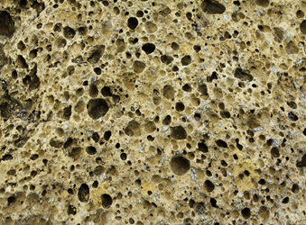

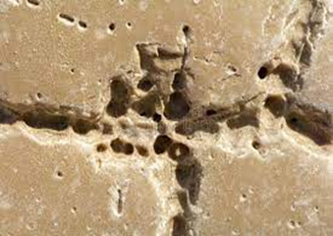
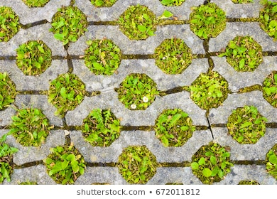
The “NATIONAL GROUNDWATER RESOURCE AND VULNERABILITY ASSESSMENT PROGRAMME (NGRVAP)”
Aquifer
Rock /sediment formation that can store and transmit water for economical use
store
(Porous Material)
Porosity
(measure of the void space in material)
transmit
Permeable Material
Permeability
( the measure of erase
through which a fluid
can pass a material)

Slide 8
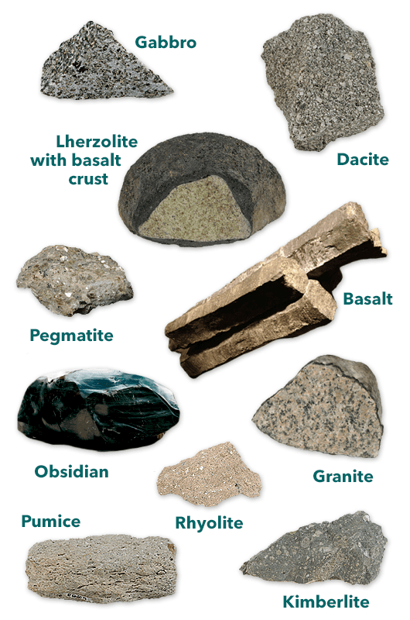
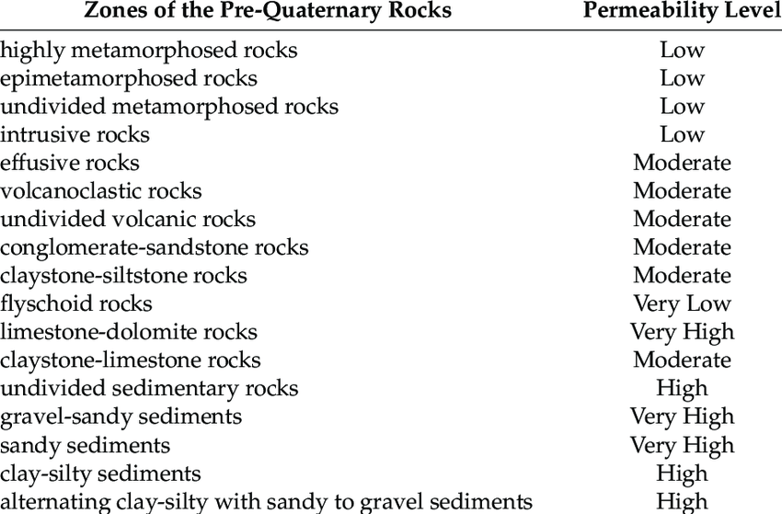
The “NATIONAL GROUNDWATER RESOURCE AND VULNERABILITY ASSESSMENT PROGRAMME (NGRVAP)”
Metamorphic Rocks
Igneous Rocks
Sedimentary Rocks

Slide 9
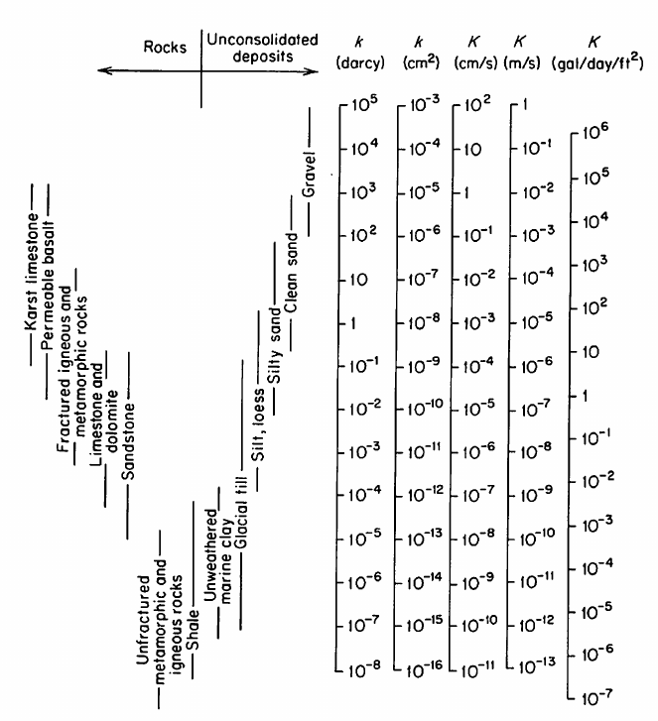
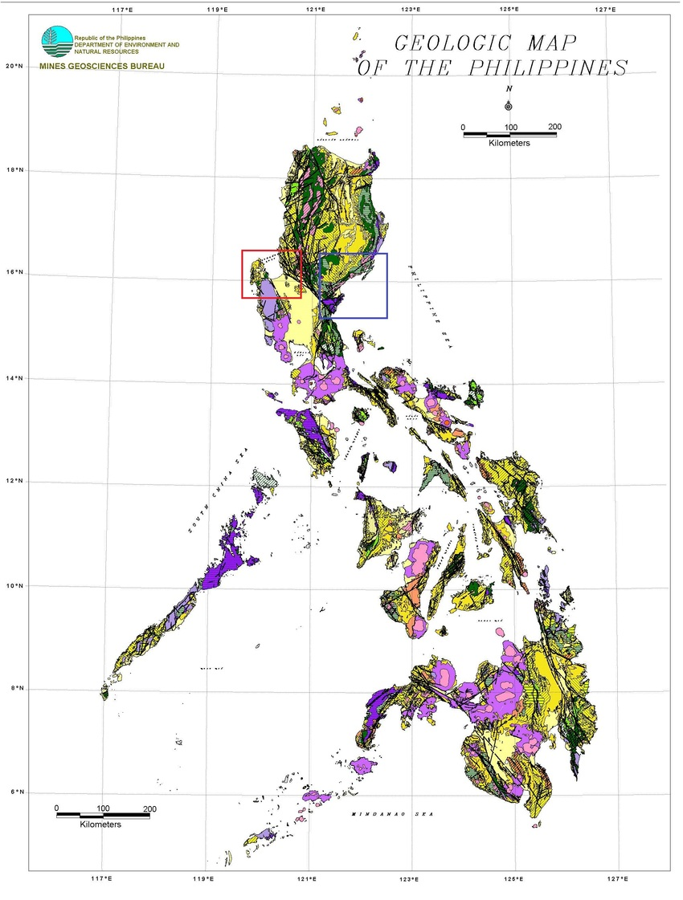
The “NATIONAL GROUNDWATER RESOURCE AND VULNERABILITY ASSESSMENT PROGRAMME (NGRVAP)”
HYDRAULIC CONDCUTIVITY OF DIFFERENT ROCK TYPES I
GEOLOGY

Slide 10
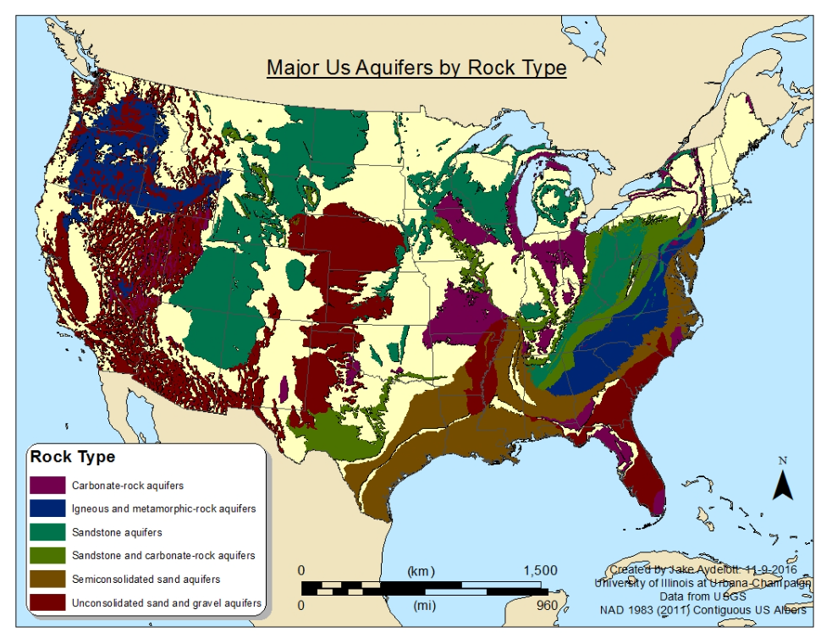
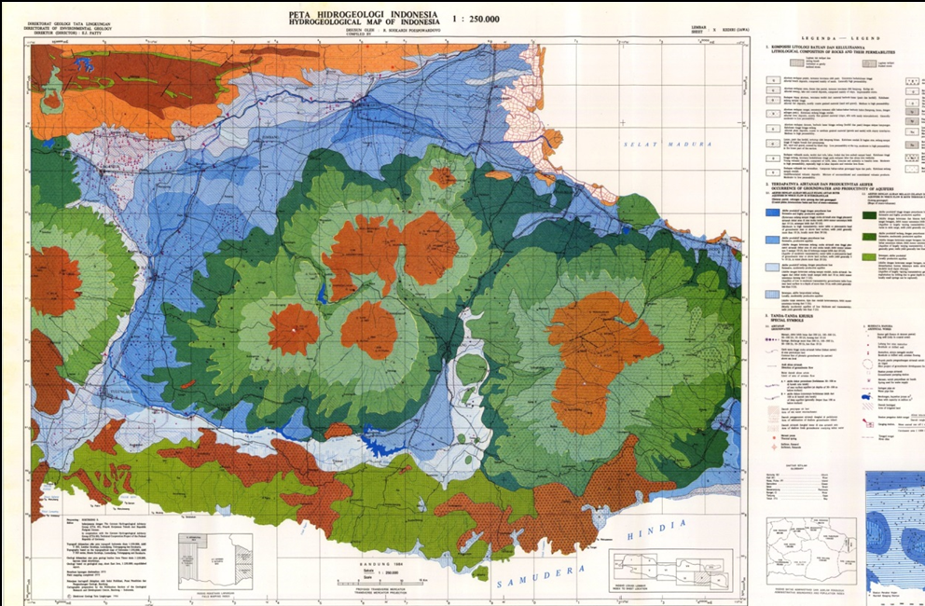
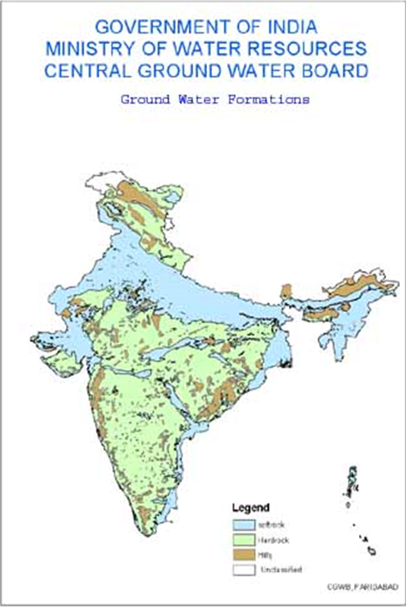
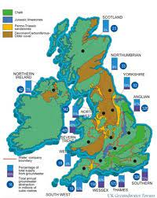
The “NATIONAL GROUNDWATER RESOURCE AND VULNERABILITY ASSESSMENT PROGRAMME (NGRVAP)”
INDONESIA
UNITED STATES OF AMERICA
UNITED KINGDOM
INDIA
GROUNDWATER AVAILABILITY MAP/
HYDROGEOLOGIC MAP/
GROUNDWATER POTENTIAL MAP
Notes:
I

Slide 11
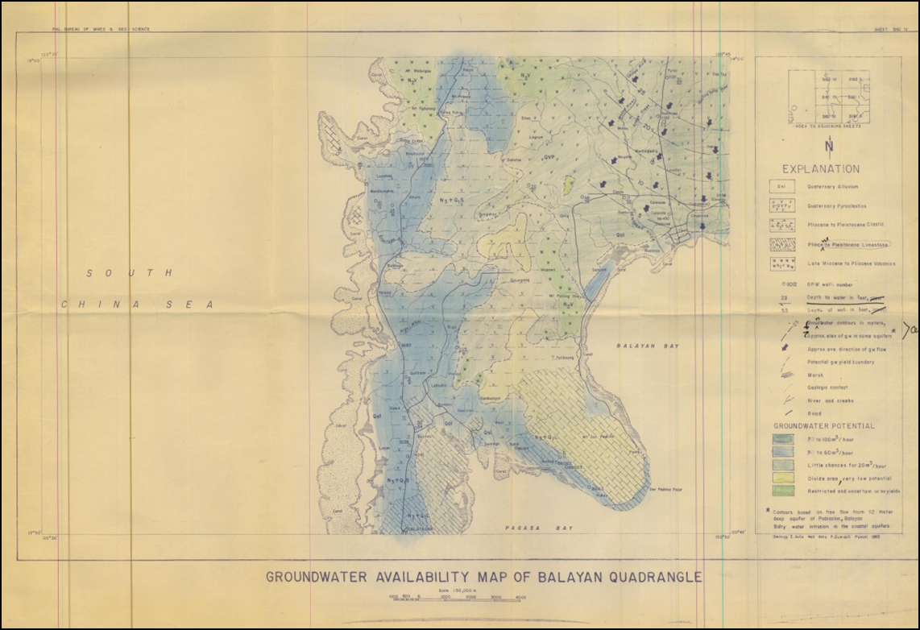
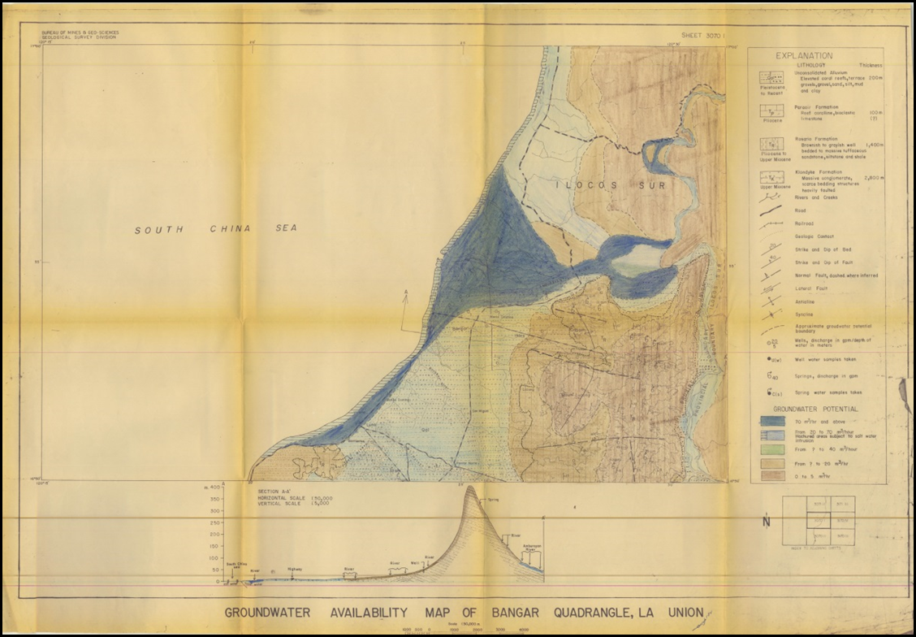
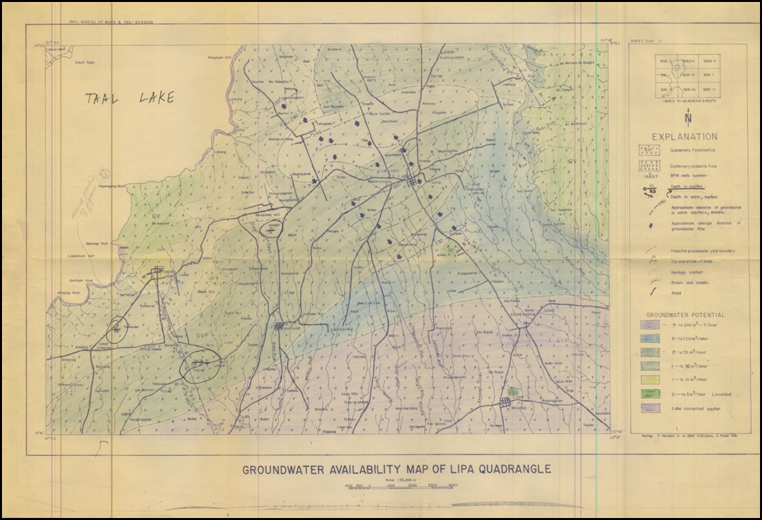
The “NATIONAL GROUNDWATER RESOURCE AND VULNERABILITY ASSESSMENT PROGRAMME (NGRVAP)”
Manually generated Groundwater Availability Map
(circa 1980s)

Slide 12
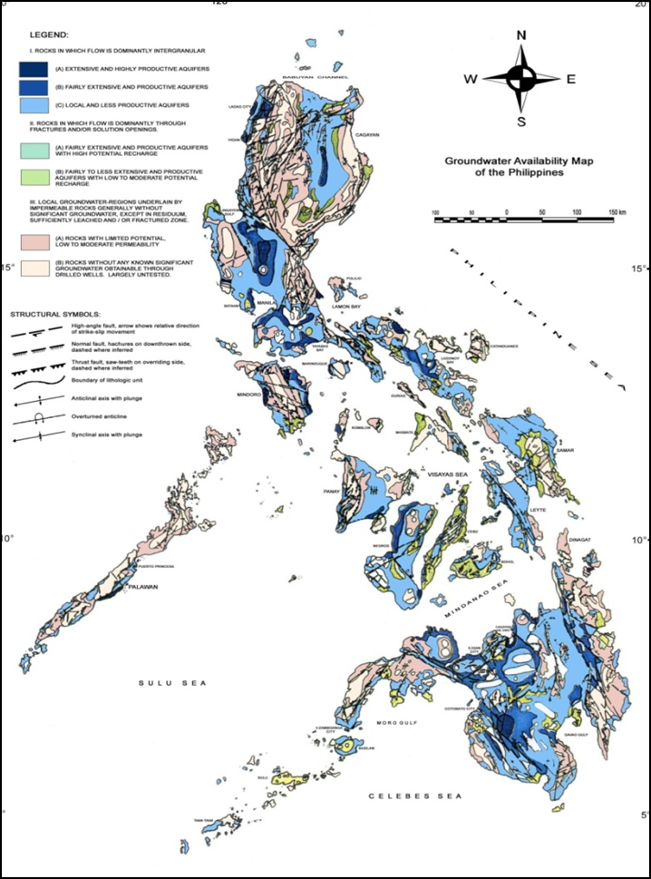
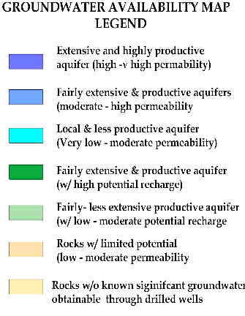
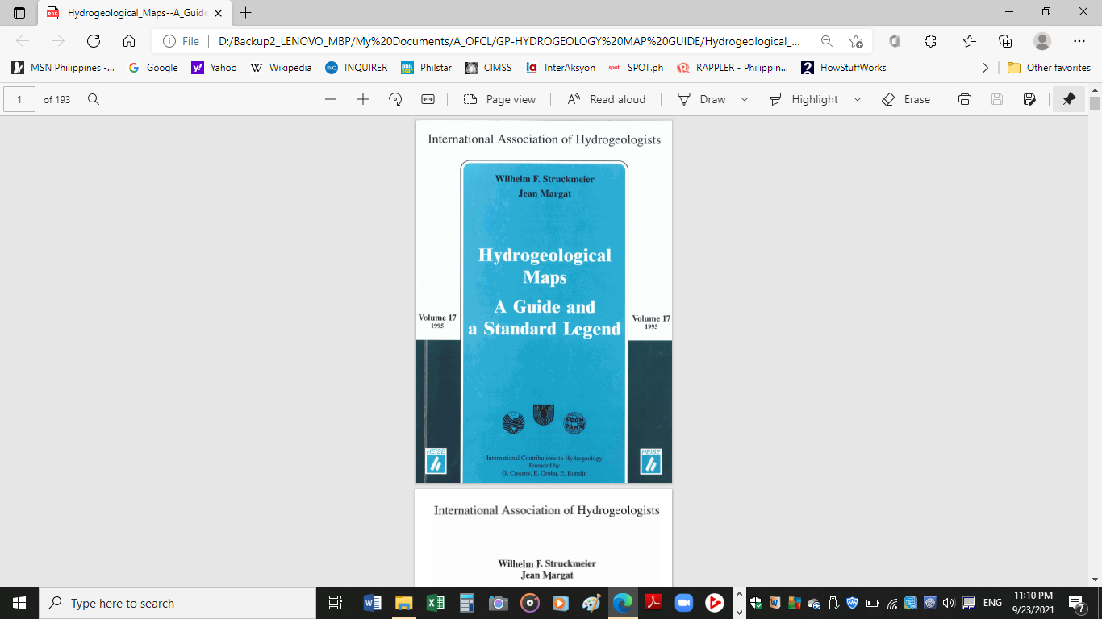
The “NATIONAL GROUNDWATER RESOURCE AND VULNERABILITY ASSESSMENT PROGRAMME (NGRVAP)”
GroundWater
Availability Map
of the Philippines
(Scale 1:2,500,000 )
UNESCO/IAH Legend (1970)
Classification of hydrogeologic units
PHILIPPINES

Slide 13
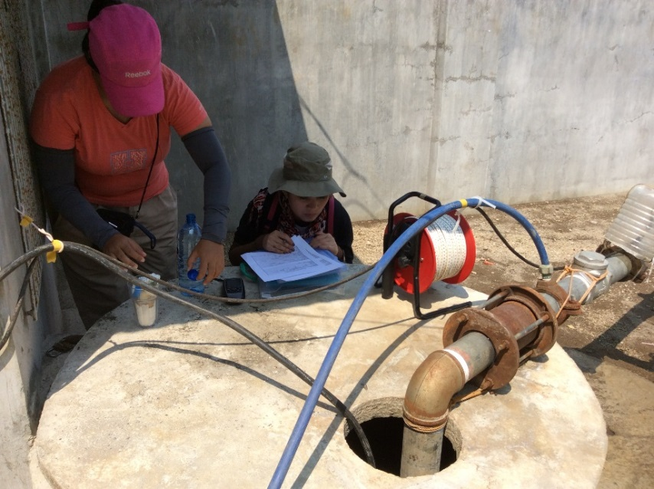
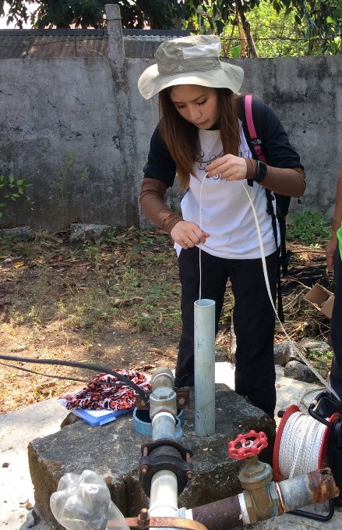
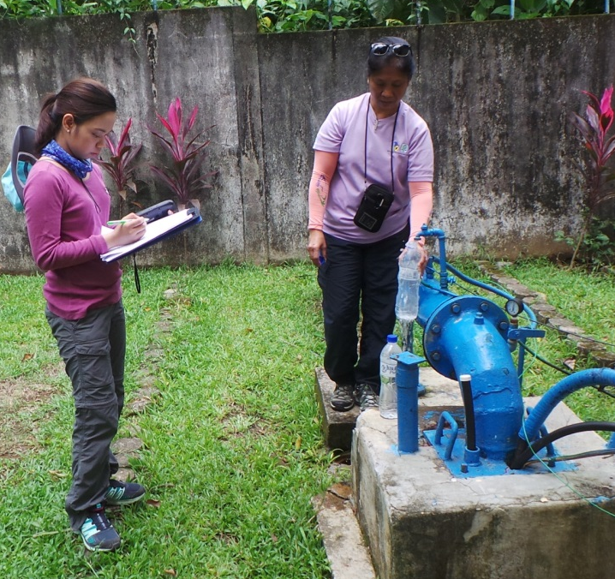
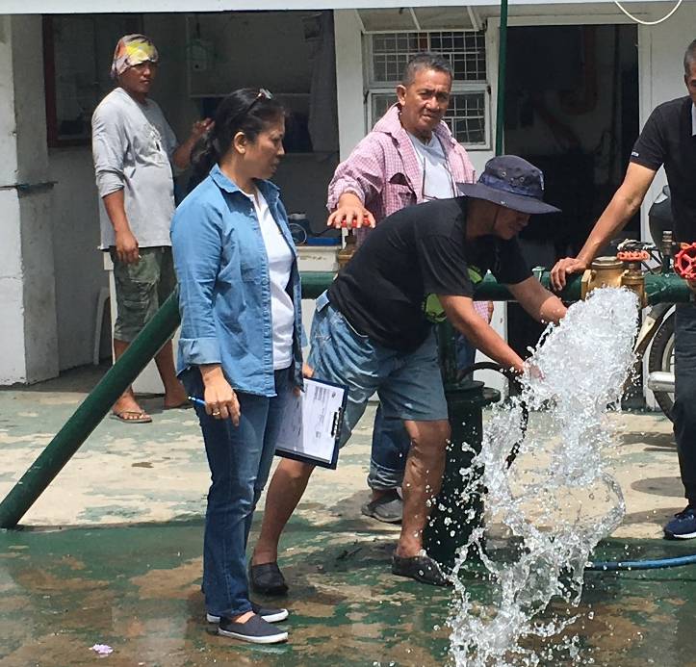
The “NATIONAL GROUNDWATER RESOURCE AND VULNERABILITY ASSESSMENT PROGRAMME (NGRVAP)”
METHODOLOGY/PROJECT ACTIVITIES
WELL INVENTORY

Slide 14
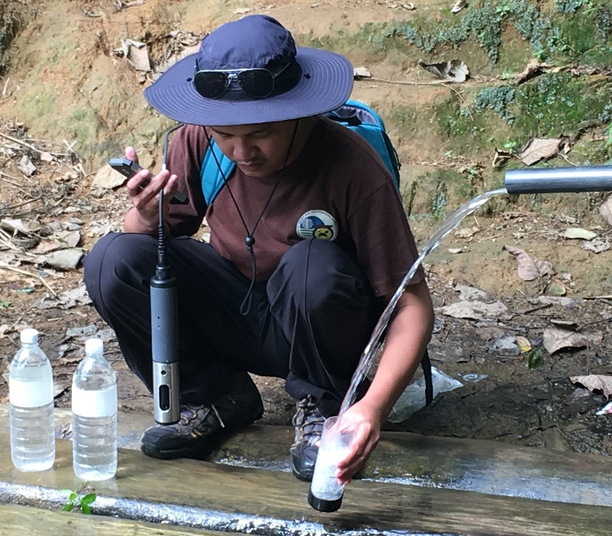
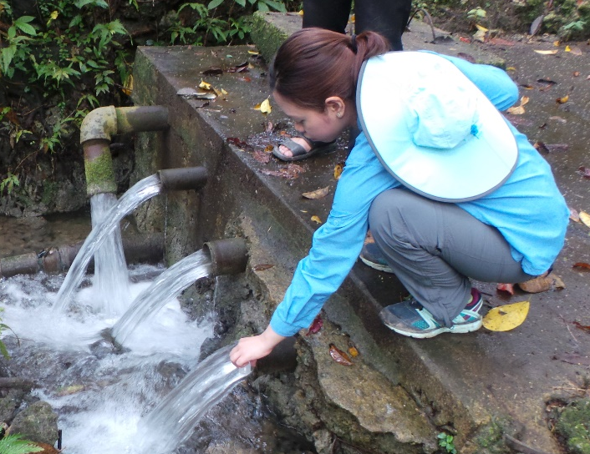
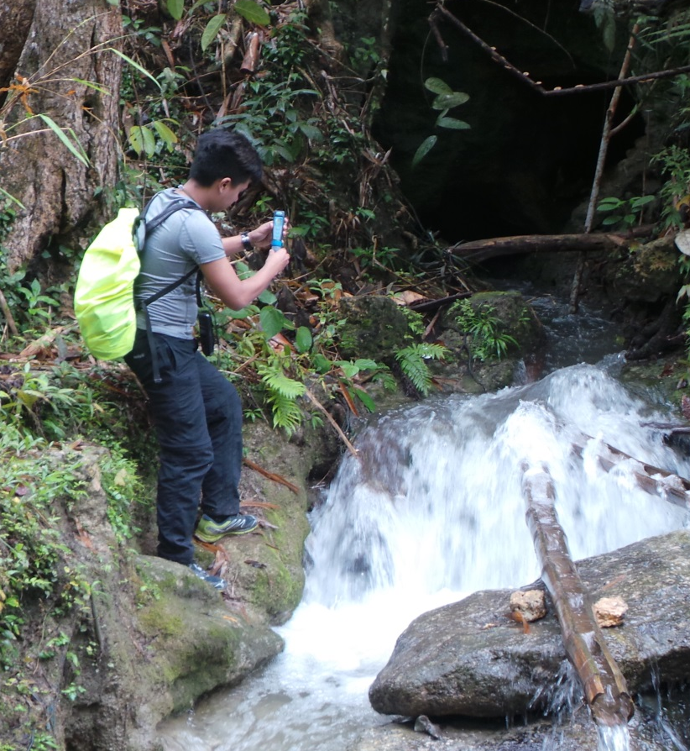
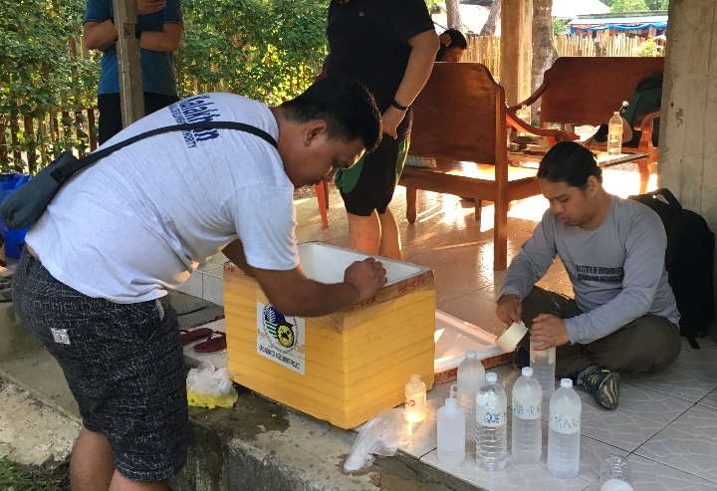
The “NATIONAL GROUNDWATER RESOURCE AND VULNERABILITY ASSESSMENT PROGRAMME (NGRVAP)”
METHODOLOGY/PROJECT ACTIVITIES
WATER SAMPLING

Slide 15
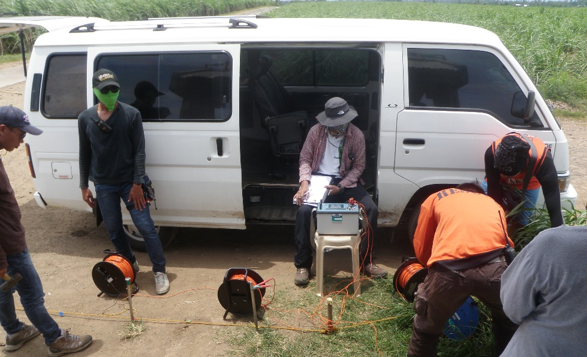
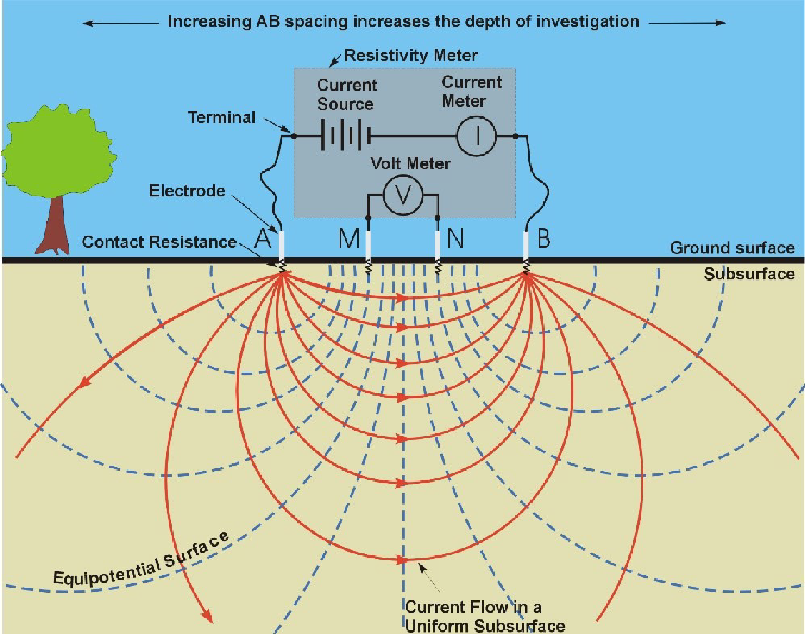
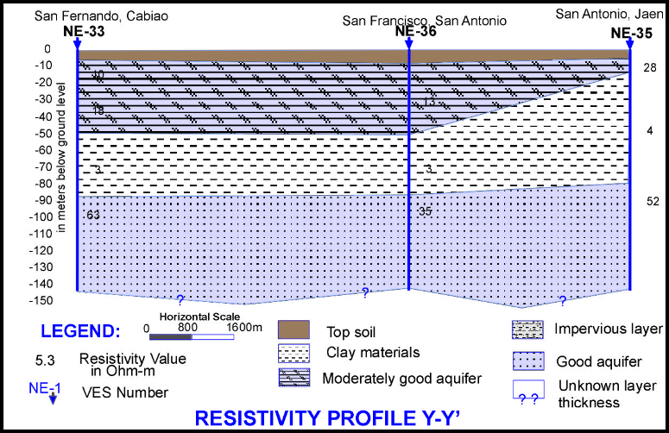
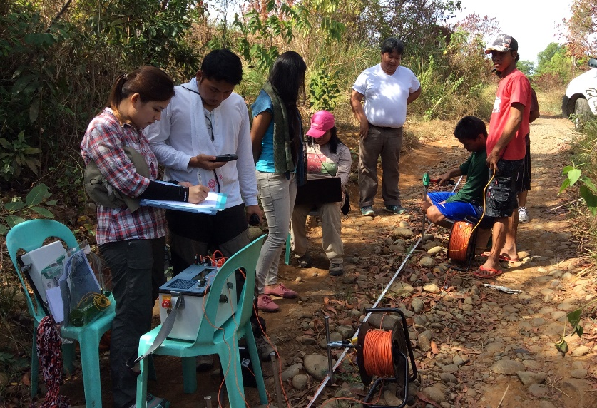
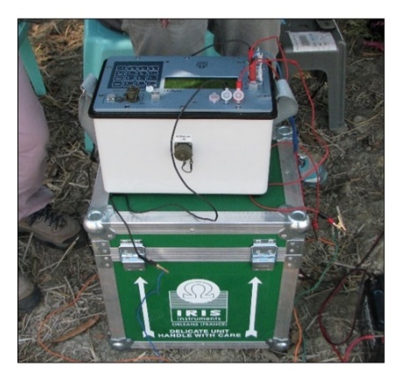
The “NATIONAL GROUNDWATER RESOURCE AND VULNERABILITY ASSESSMENT PROGRAMME (NGRVAP)”
METHODOLOGY/PROJECT ACTIVITIES
GEORESISTIVITY SURVEY
Layer No. | Resistivity Value (Ω-m) | Thickness (in meter) | Depth (in meter)
1 | 47.5 | 0.2 | 0
2 | 117.1 | 1.2 | 0.2
3 | 61.7 | 6 | 1.4
4 | 37.1 | 16.5 | 7.4
5 | 7 | 66 | 23.9
6 | 110.4 |  | 89.9

Slide 16
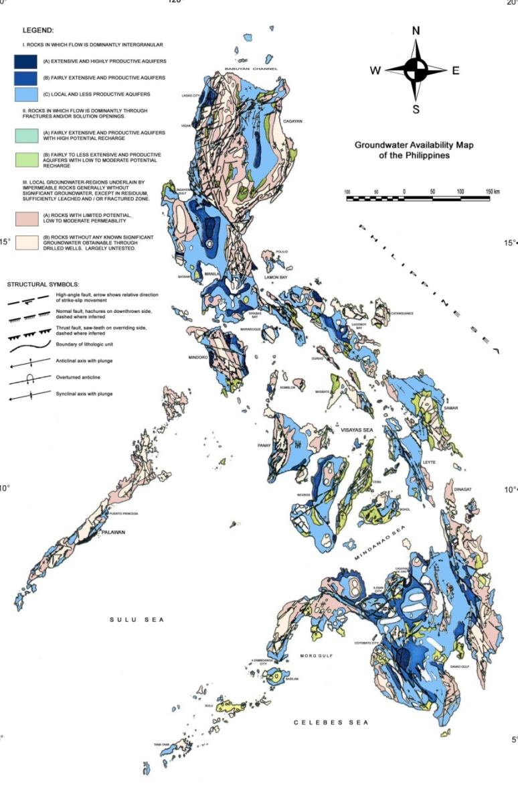
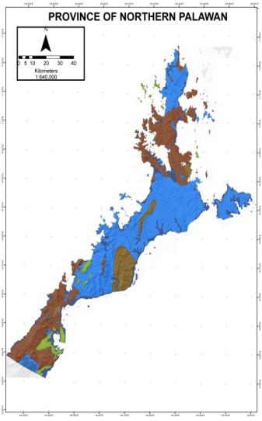
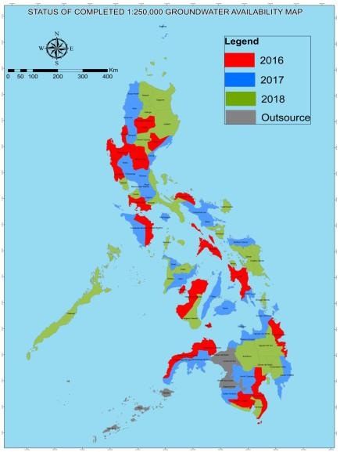
The “NATIONAL GROUNDWATER RESOURCE AND VULNERABILITY ASSESSMENT PROGRAMME (NGRVAP)”
2016 - 20
2017 - 31
2018 - 25
TOTAL = 76 ( 93% of the total 81
Provinces in the Phil
National
Scale 1:2,500,00
Regional ( Provincial level)
Scale 1:250,000

Slide 17
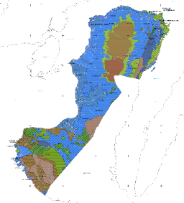
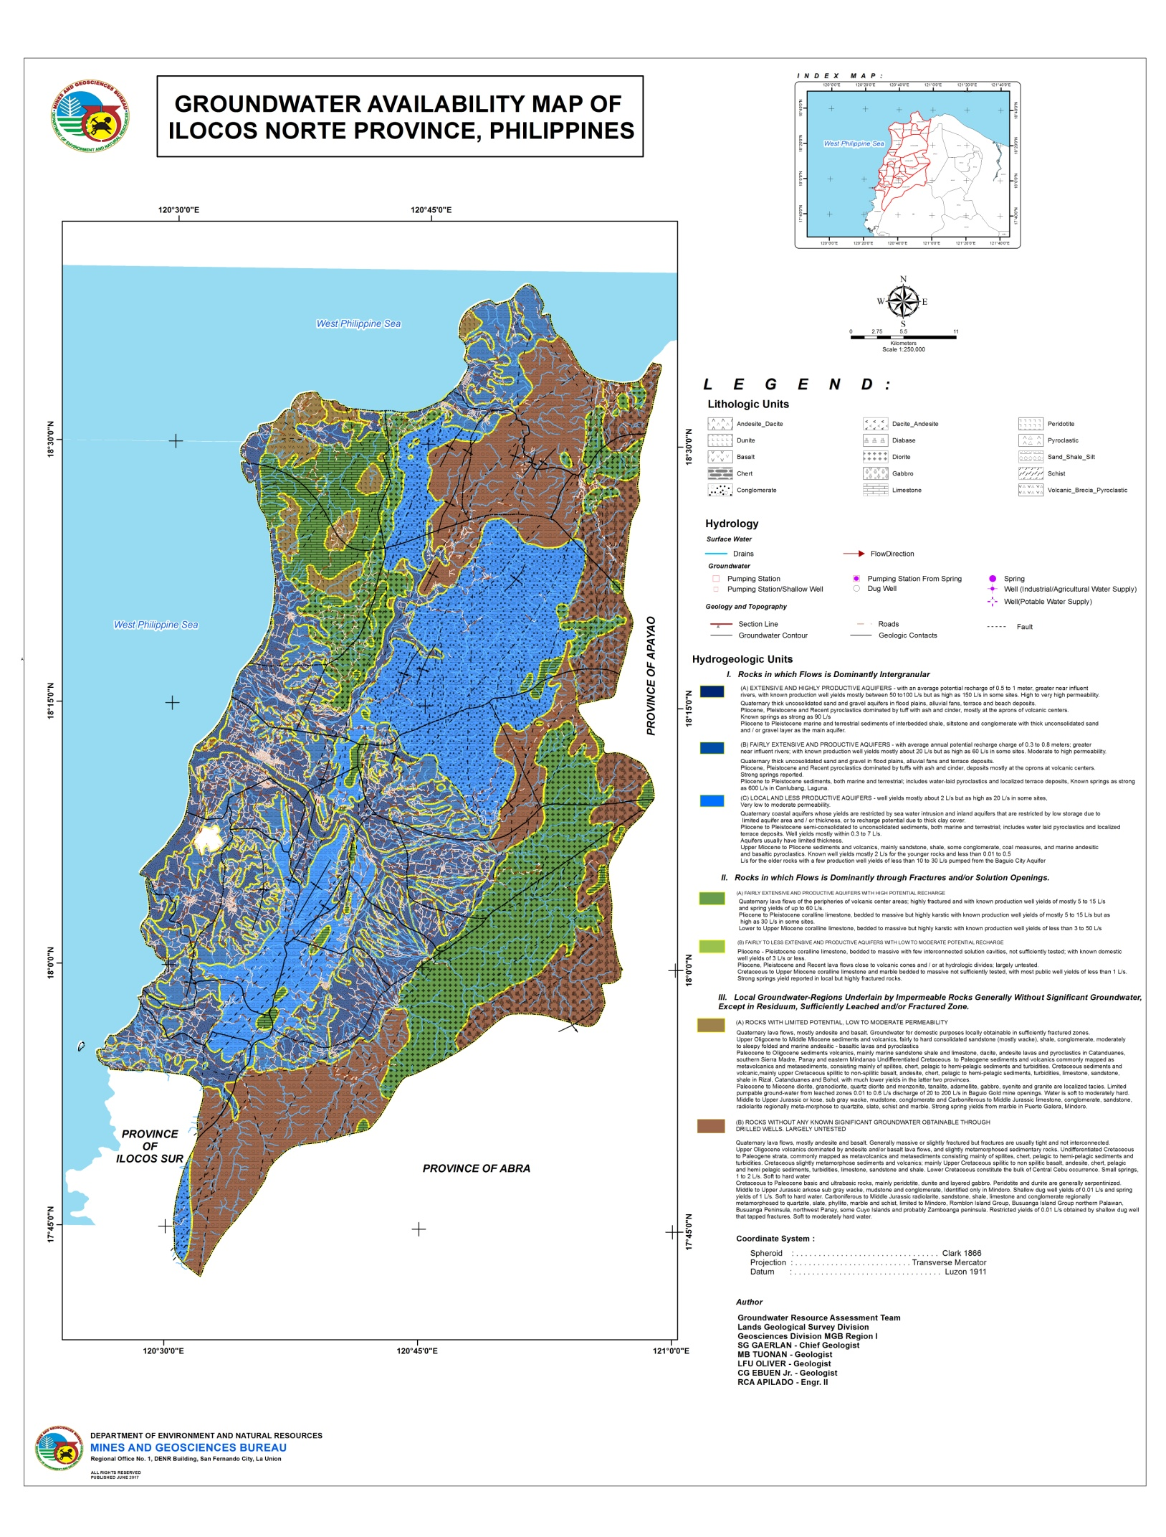
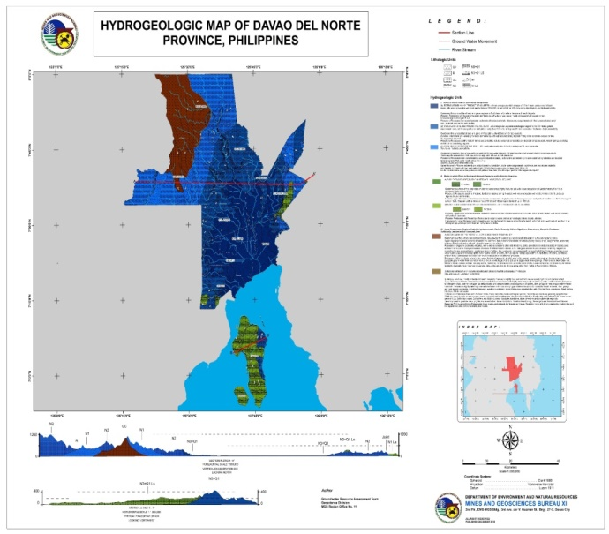
The “NATIONAL GROUNDWATER RESOURCE AND VULNERABILITY ASSESSMENT PROGRAMME (NGRVAP)”
GROUNDWATER AVAILABILITY MAP
Provincial level, 1:250,000

Slide 18
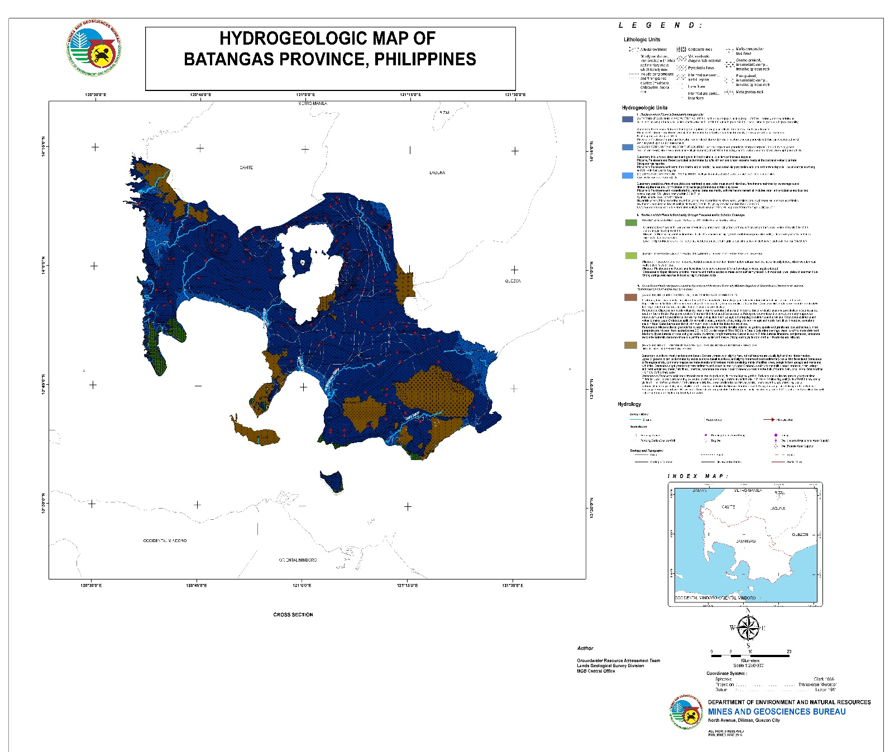
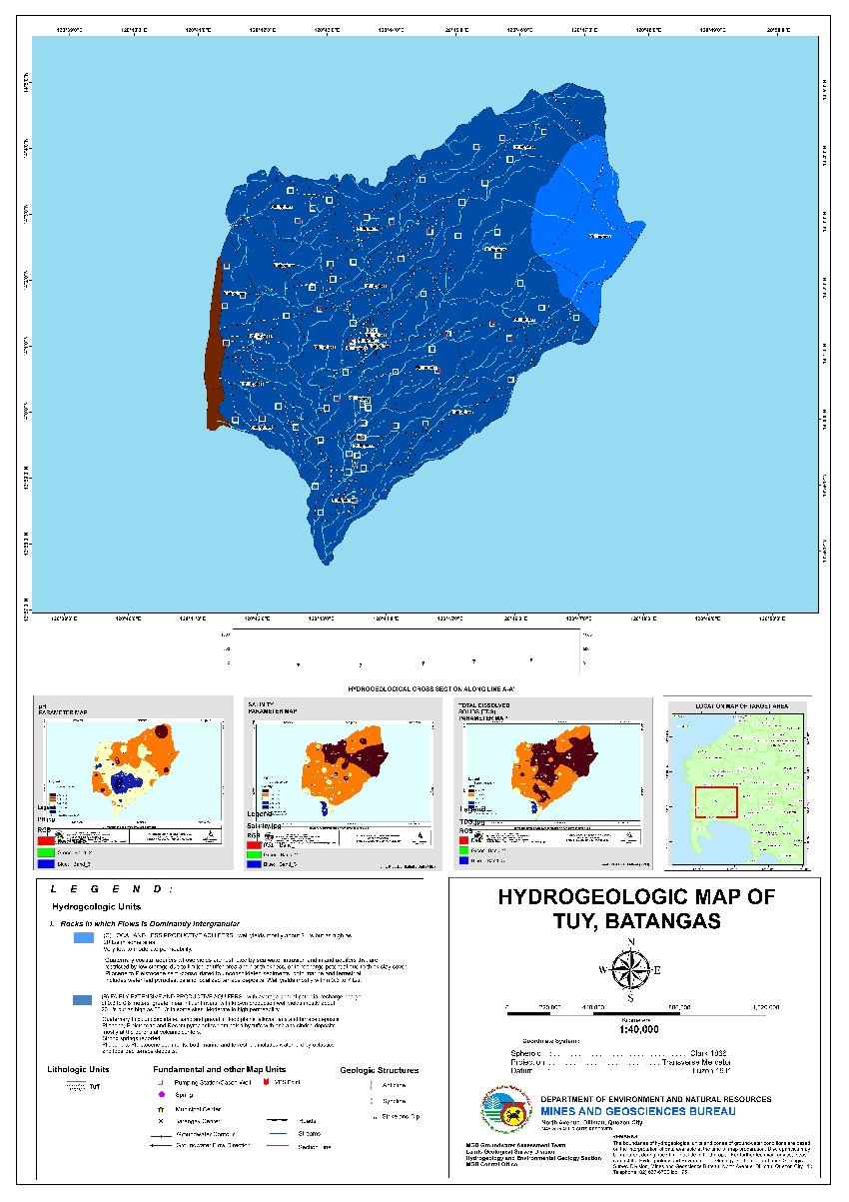
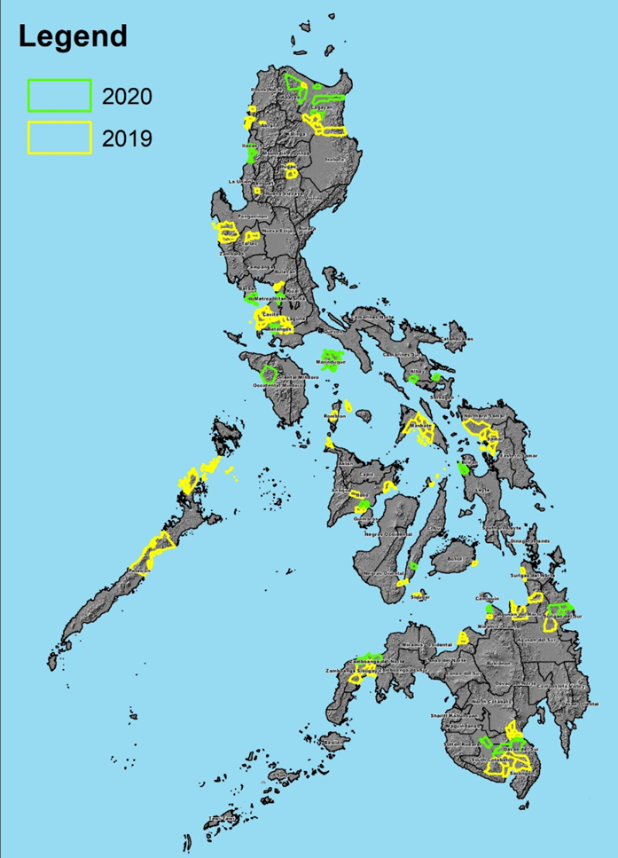
The “NATIONAL GROUNDWATER RESOURCE AND VULNERABILITY ASSESSMENT PROGRAMME (NGRVAP)”
2019 - 92
2020 - 49
2021 - 52
TOTAL -193
(12% of 1,506
municipalities/cities in the Phil)
Regional (Provincial level)
Scale 1:250,000
Semi-detailed (Municipal/City level)
Scale 1:50,000

Slide 19
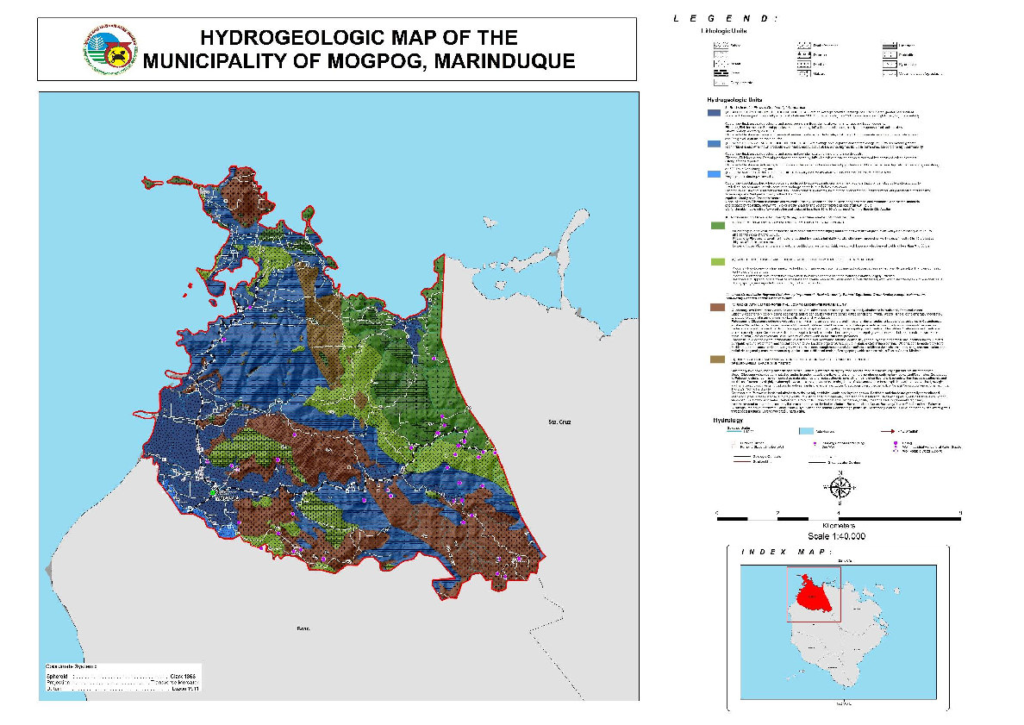
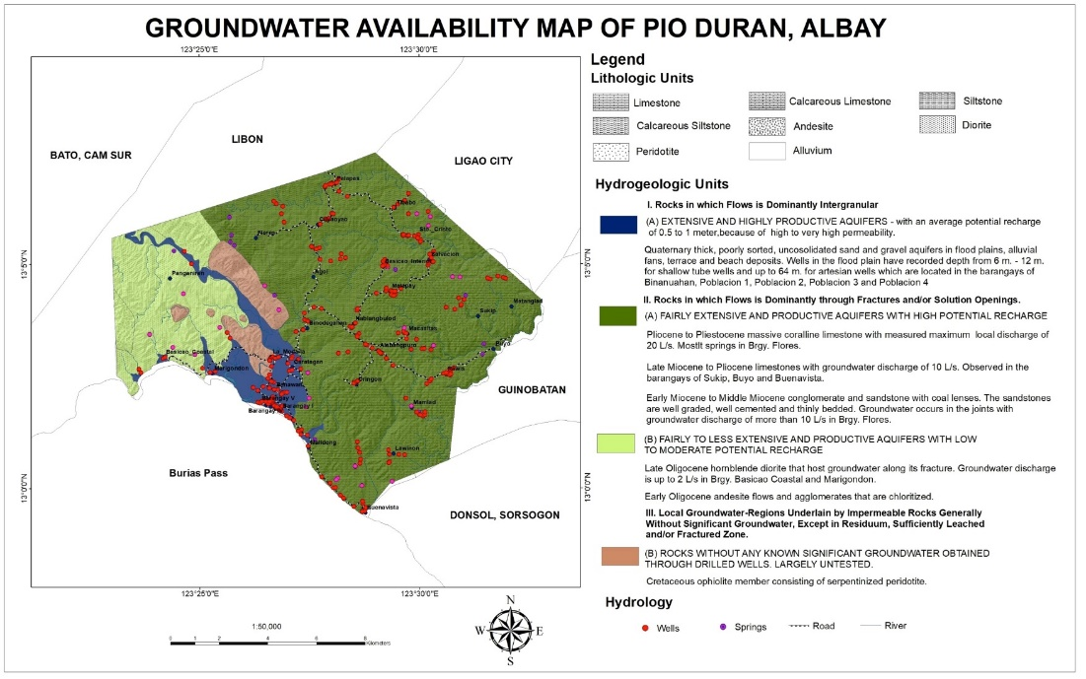

The “NATIONAL GROUNDWATER RESOURCE AND VULNERABILITY ASSESSMENT PROGRAMME (NGRVAP)”
GROUNDWATER AVAILABILITY MAP /HYDROGEOLOGIC MAP
Municipal level, 1:50,000
Notes:
It is dynamic; always in motion and it move from high pressure area to low pressure area
It is a natural mineral resource referred to as the “New Gold” dut to its extreme importance to human existence

Slide 20


The “NATIONAL GROUNDWATER RESOURCE AND VULNERABILITY ASSESSMENT PROGRAMME (NGRVAP)”
Blue area | 159,473.50 km² | Well yield Max of 150 lps to min of 5 lps
Green Area | 60,32.24 km² | Well yield Max 60 lps to min of 2 lps
Brown Area | 80,202.26 km² | Well yield Max of 20 lps to < 2 lps
Approximately 50,000 square km (or 31 % of the blue area) is considered groundwater reservoir contributing about 14% of the total water resource potential of the country .
Regions I, II, III and VII have the highest potential while Region X has the lowest.
Assessment priority is given to province experiencing water supply shortages due to the effect of climate change & increase water demand from rapid population and economic growth

Slide 21
www.mgb.gov.ph
Direct Link:
lgsd.mgb.gov.ph/mgbgoogle
Email us:
hegs@mgb.gov.ph

Slide 22

THANK YOU FOR LISTENING

Slide 23
The “NATIONAL GROUNDWATER RESOURCE AND VULNERABILITY ASSESSMENT PROGRAMME (NGRVAP)”
GROUNDWATER QUALITY
In general, growndwater pumped from the Quaternary clastic and pyroclastic rocks, sand and gravel
deposits is of acceptable
High chloride concentrations is commonly obtained from very well confined formation that are not
sufficiently flushed
- All marine sedimentary formations are normally salty at depths exceeding 1,000 meters
- Unconfined and low pressure confined water is underlain by saline water at the coastal zone
In general, growndwater from the crystalline rocks is of high physical and chemical quality, although pH
is commonly acidic at 6 to 6.5. Acidic sulfuric acid waters are common in the Quaternary sulfataric areas.
High sulfate waters occurs in the pyritized oxidized zones.
High or objectionable concentrationof iron (Fe⁺⁺) are likely to occur in highly oxidized aquifers and /or
recharge source

Slide 24


Slide 26





The “NATIONAL GROUNDWATER RESOURCE AND VULNERABILITY ASSESSMENT PROGRAMME (NGRVAP)”
GEOLOGY

